Slide 1
COVID-19 Detection in Chest X-Ray Images
Isaac McPadden

Slide 2
The Dataset
221 chest X-rays of people with COVID-19
234 chest X-rays of people with normal lung function
148 chest X-rays of people with pneumonia
Total of 603 X-rays with 37% COVID, 39% Normal, and 24% Pneumonia

Slide 3
Goals
Create a model that can detect COVID-19 in chest X-rays and differentiate between COVID-19 and pneumonia
Compare models to see which is best at classifying chest X-rays

Slide 4
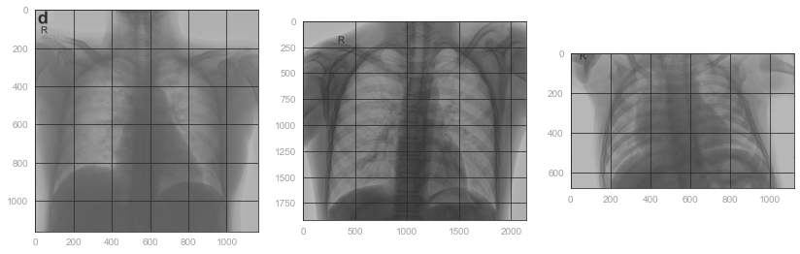
Preprocessing
COVID-19
Normal
Pneumonia

Slide 5
Preprocessing
Images are black and white jpegs and pngs
Stored in folder named Dataroot
Subfolders were the classification of each image
Ran through each subfolder importing images and added the subfolder name to a list during each iteration
Images were imported as grayscale (each pixel has an integer value of 0-255 signifying brightness) 2D arrays
Grayscale values were converted to floats and were divided by 255 to feed values between 0 and 1 to the models
The image was then resized to 256x256 pixels using skimage (larger was taking too long)
The image was flattened to a 1D array and added to a list
The two lists (image array and classification from the folder name) were combined into a dataframe
The classification column was converted to numeric encoding using LabelEncoder

Slide 6
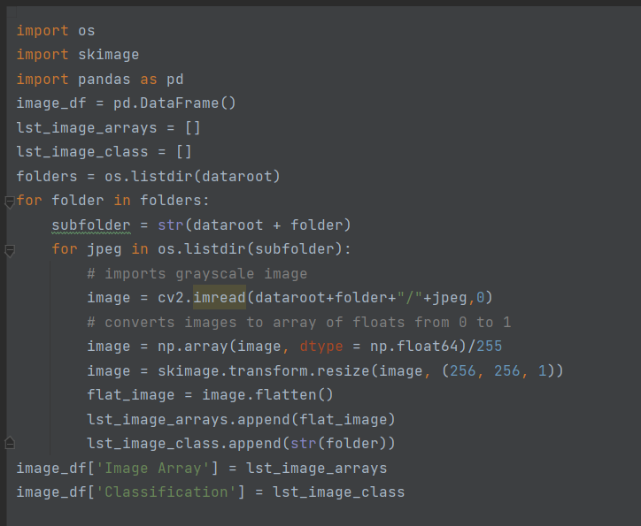

Slide 7
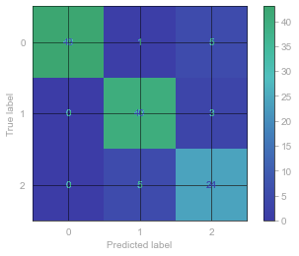

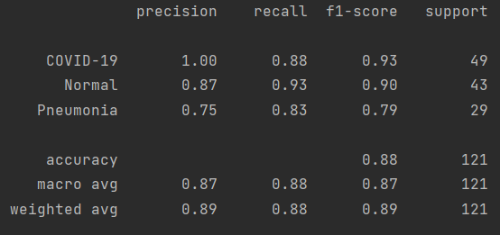
Linear Support Vector Classifier

Slide 8
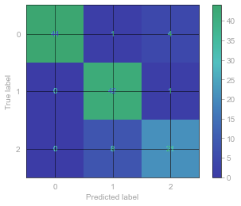

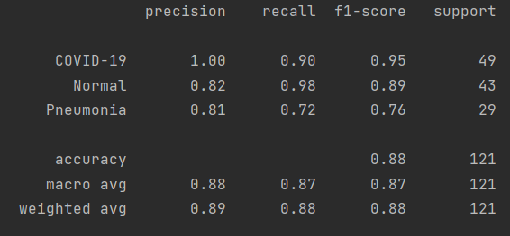
Stochastic Gradient Descent Classifier

Slide 9
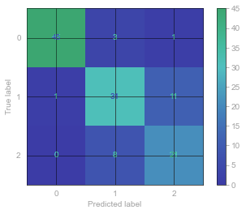

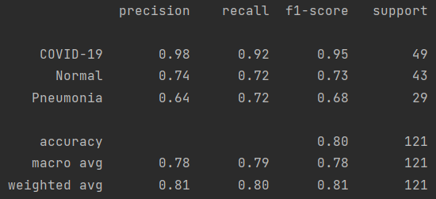
K-Nearest Neighbors Clustering Classification

Slide 10
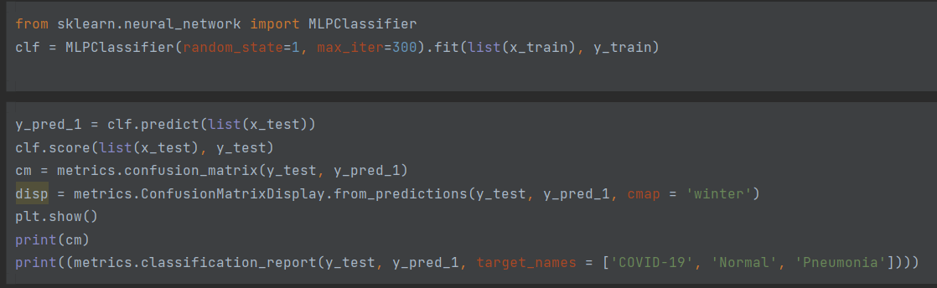
MLP (Multi-layer perceptron) Classifier (basic neural network)
With default parameters:

Slide 11
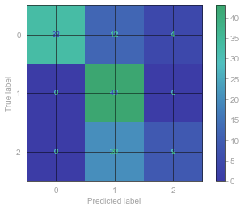

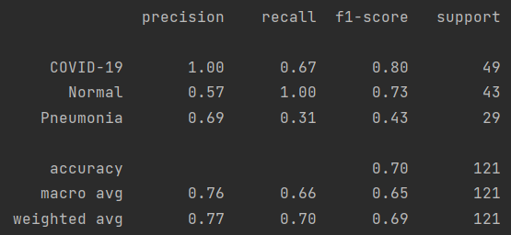
MLP (Multi-layer perceptron) Classifier (basic neural network)

Slide 12
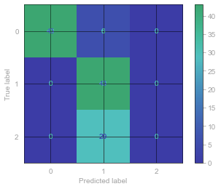
MLP (Multi-layer perceptron) Classifier (basic neural network)
Nonsense for pneumonia classification with hidden layer sizes of 50, 25

Slide 13


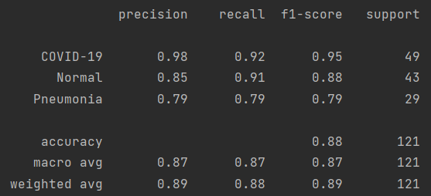
MLP (Multi-layer perceptron) Classifier (basic neural network)

Slide 14
Conclusions
Predictions tended to have high accuracy for classifying an X-ray as COVID
Recall for COVID was lower and Normal was higher suggesting pneumonia cases were getting misclassified as COVID in the LinearSVC, SGD, and KNN models
KNN was the worst non-perceptron model
SGD and LinearSVC had similar results which makes sense because they are both types of SVMs
MLP classifier needs more tuning
All models could likely be improved by experimenting with hyperparameters
Could also increase size of dataset by modifying the images

Slide 15
Work Breakdown
50% Preprocessing
35% Analysis
15% Visuals

